Slide 1

6th Grade Accelerated Math
Unit 14, Lesson 6 Solving One-Step Multiplication and Division Equations in One Variable Using Models Volume 2, pg. 367

Slide 2


Benchmark
MA.6.AR.2.3
Write and solve one-step equations in one variable within a mathematical or real-world context using multiplication and division, where all terms and solutions are integers.
volume 2, pg. 367

Slide 3
Integrated Mathematical Thinking and Reasoning Standards
MA.K12.MTR.1.1 Actively participate in effortful learning both individually and collectively.
MA.K12.MTR.2.1 Demonstrate understanding by representing problems in multiple ways.
MA.K12.MTR.4.1 Engage in discussions that reflect on the mathematical thinking of self and others.
MA.K12.MTR.5.1 Use patterns and structure to help understand and connect mathematical concepts.
volume 2, pg. 367

Slide 4

Learning Targets
I can solve one-step multiplication and division equations using manipulatives.
I can solve one-step multiplication and division equations using diagrams.
volume 2, pg. 367

Slide 5

Warm-Up
volume 2, pg. 367

Slide 6
14.6.1 Warm-Up: Math Fail
This children’s book has published a “math fail.”
Explain the error shown in this image.
volume 2, pg. 367

Slide 7

Exploration
volume 2, pg. 368

Slide 8



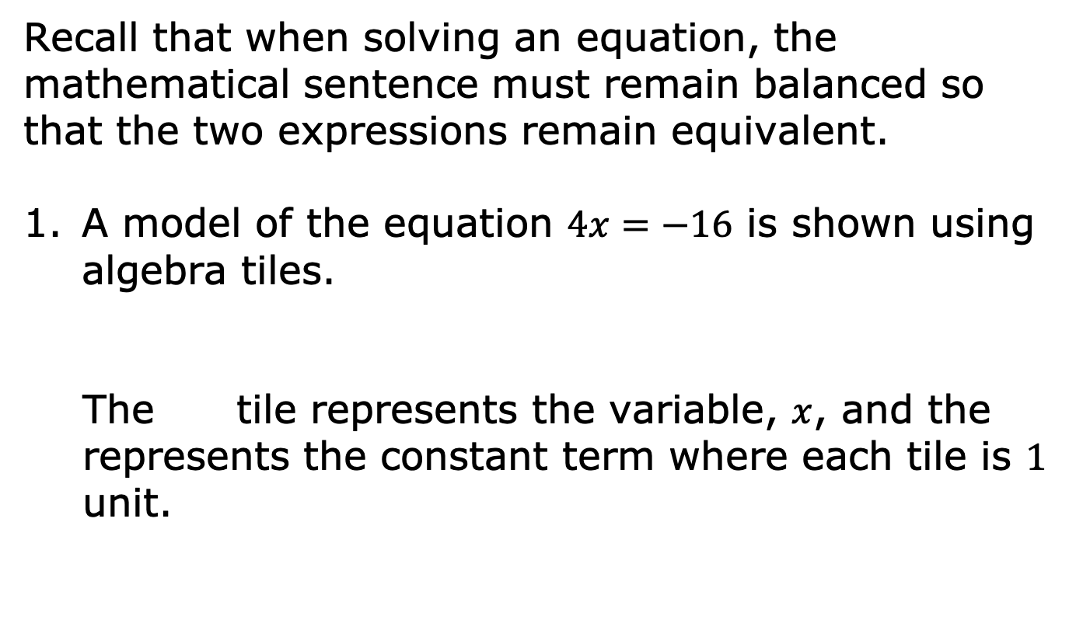
14.6.2 Exploration: Exploring Relationships
Recall that when solving an equation, the mathematical sentence must remain balanced so that the two expressions remain equivalent.
A model of the equation $4x=−16$ is shown using algebra tiles.
The tile represents the variable, $x$, and the represents the constant term where each tile is $1$ unit.
volume 2, pg. 368

Slide 9
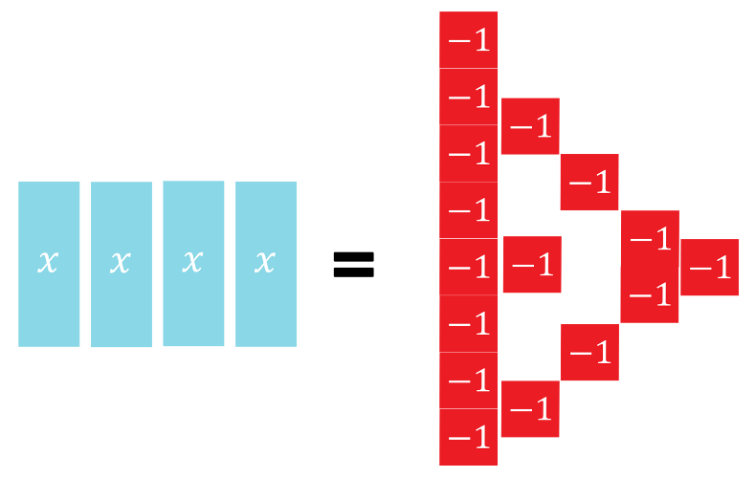

What operation is being applied to the $4$ and the $x$ in the equation $4x=−16$?
volume 2, pg. 368

Slide 10
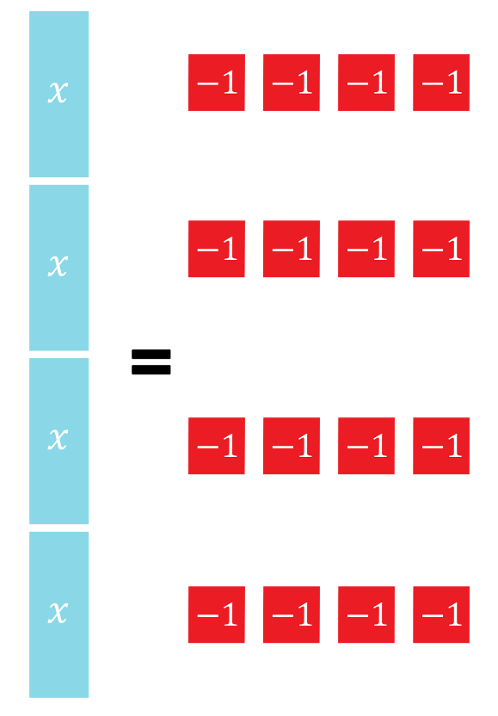
The algebra tiles are arranged on the equation mat into equal-sized groups on both sides of the equation. How many groups were created?
volume 2, pg. 368

Slide 11
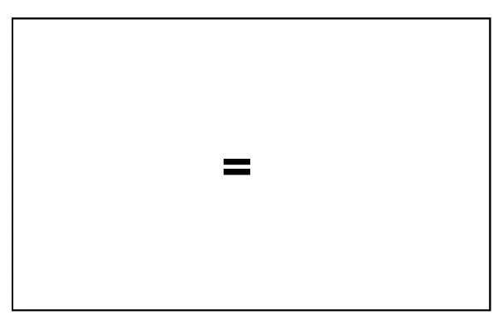
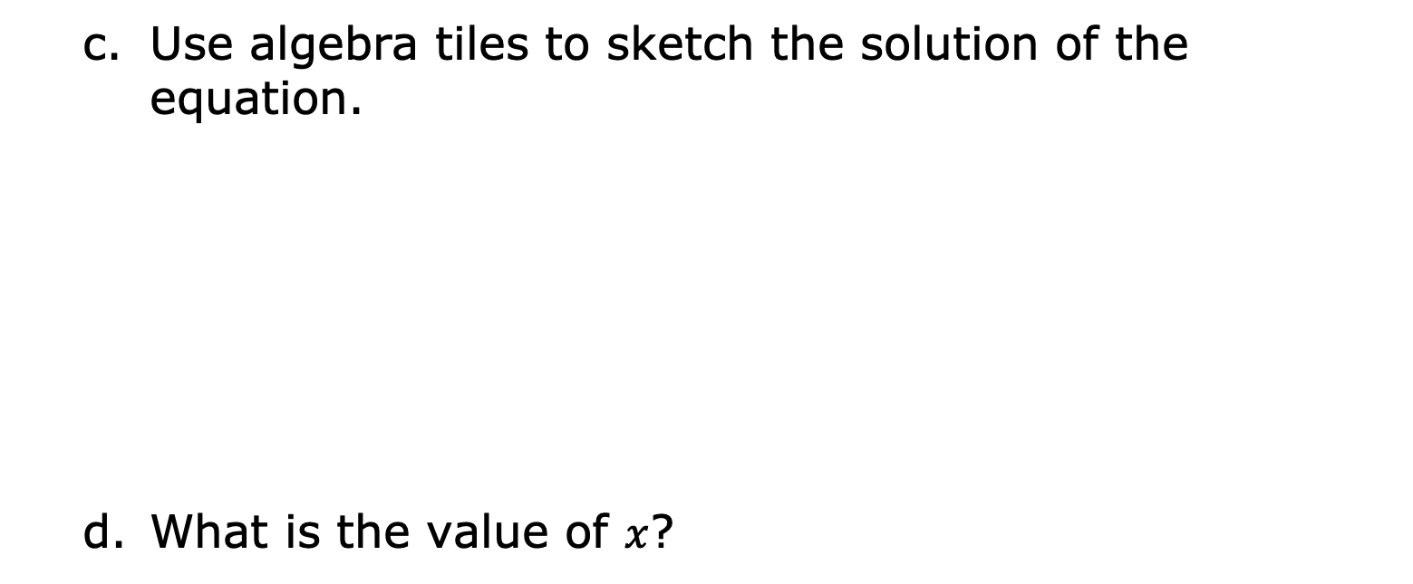
Use algebra tiles to sketch the solution of the equation.
What is the value of $x$?
volume 2, pg. 368

Slide 12
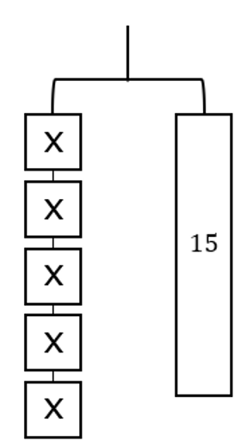
The hanger diagram represents the equation $5x=15.$
volume 2, pg. 369

Slide 13
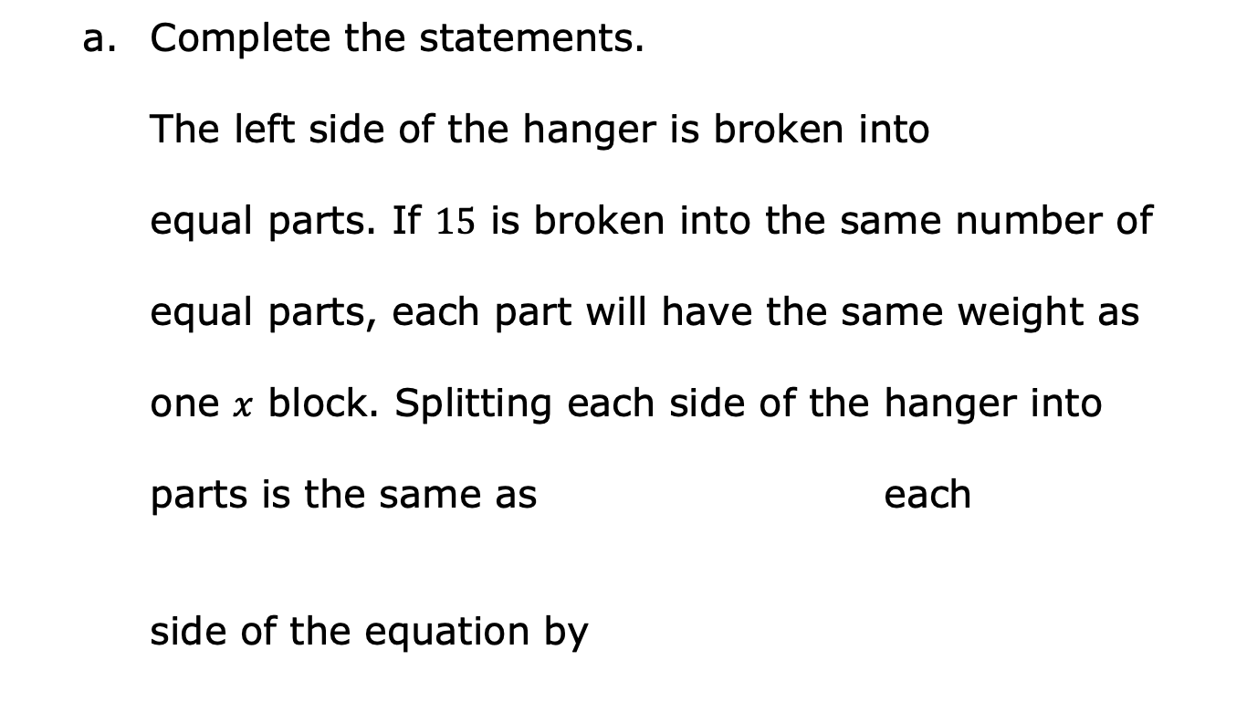

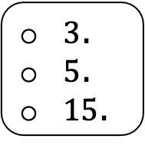
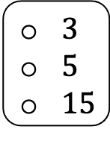
Complete the statements.
The left side of the hanger is broken into
equal parts. If $15$ is broken into the same number of
equal parts, each part will have the same weight as
one $x$ block. Splitting each side of the hanger into
parts is the same as each
side of the equation by
$3$
$5$
$15$
dividing
multiplying
$3$
$5$
$15$
$3$.
$5$.
$15$.
volume 2, pg. 369

Slide 14
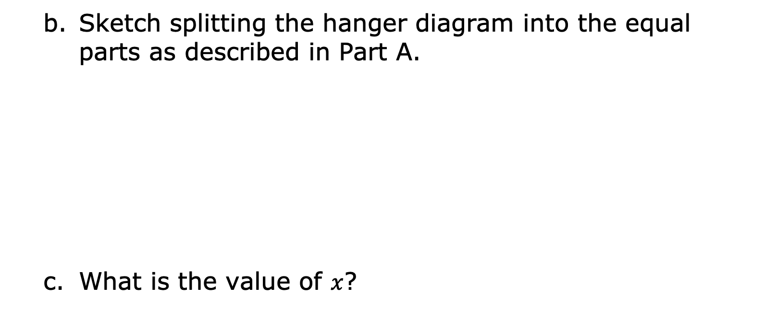
Sketch splitting the hanger diagram into the equal parts as described in Part A.
What is the value of $x$?
volume 2, pg. 369

Slide 15
Compare your diagram with your partner. Discuss the similarities and differences.
Provide positive feedback to your partner in their book on their sketch and solution.
Partner Feedback
volume 2, pg. 369

Slide 16
Inverse operations can be helpful in solving equations.
Draw an arrow to match each operation on the left with its inverse operation on the right.
division | division
addition | addition
subtraction | subtraction
multiplication | multiplication
volume 2, pg. 370

Slide 17
Explain what it means for operations to be inverses.
Which inverse operations were used to solve the equations in this exploration?
volume 2, pg. 370

Slide 18

Guided Instruction
volume 2, pg. 370

Slide 19
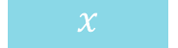
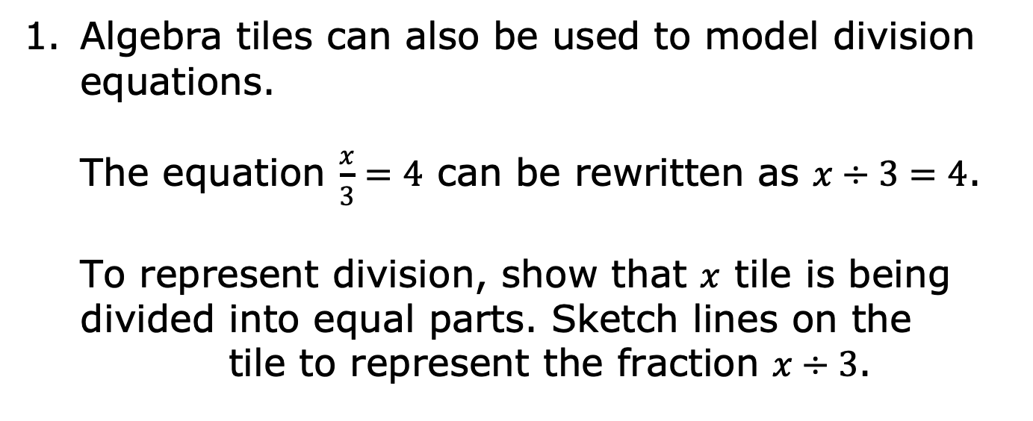
14.6.3 Guided Instruction: Using Models to Solve Equations
Algebra tiles can also be used to model division equations.
The equation $\frac{x}{3}=4$ can be rewritten as $x÷3=4$.
To represent division, show that $x$ tile is being divided into equal parts. Sketch lines on the tile to represent the fraction $x÷3$.
volume 2, pg. 370

Slide 20
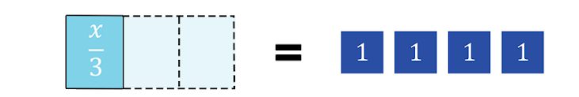
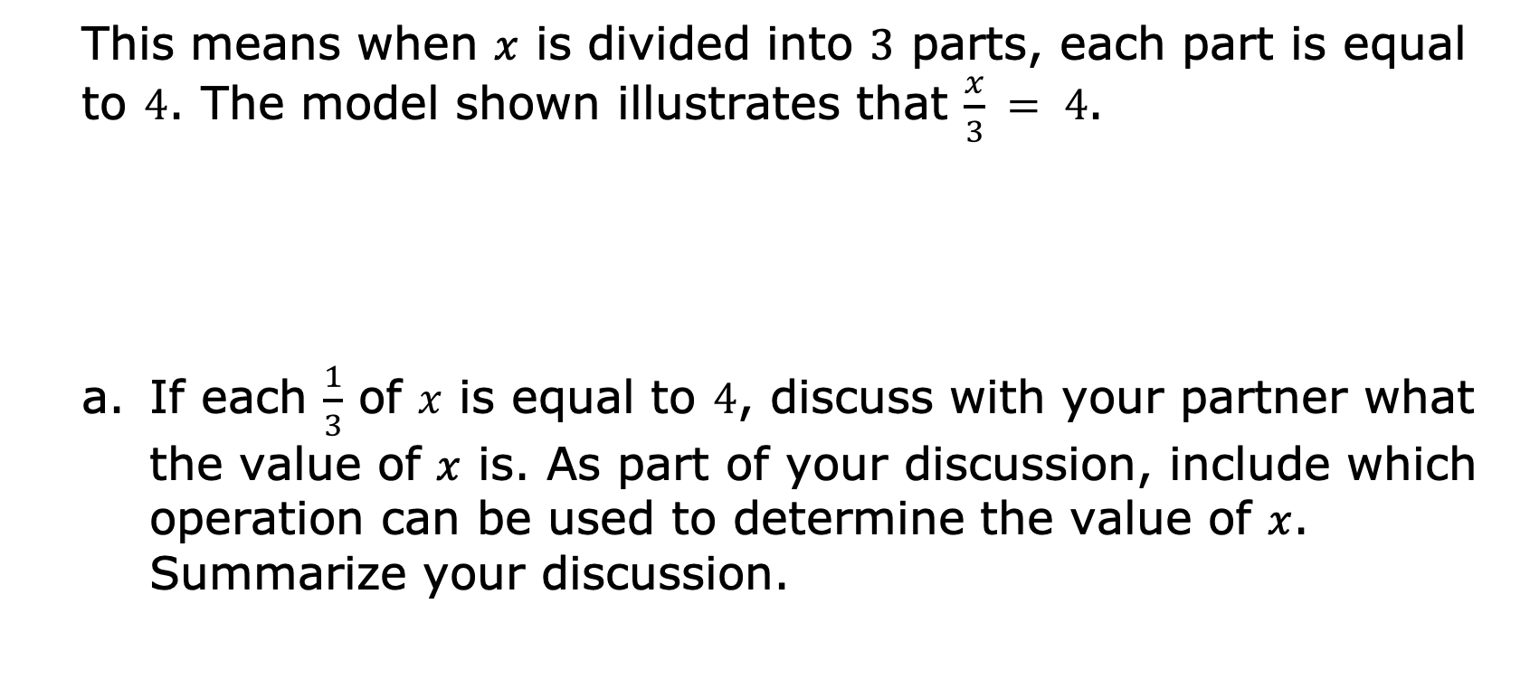
This means when $x$ is divided into $3$ parts, each part is equal to $4$. The model shown illustrates that $\frac{x}{3} = 4$.
If each $\frac{1}{3}$ of $x$ is equal to $4$, discuss with your partner what the value of $x$ is. As part of your discussion, include which operation can be used to determine the value of $x$. Summarize your discussion.
volume 2, pg. 370

Slide 21
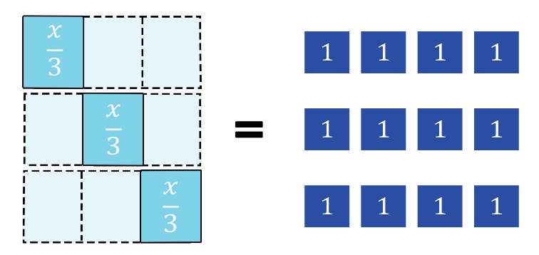

The image models the relationship discussed that can be used to determine the value of $x$.
Explain how this representation can be used to determine the value of .
volume 2, pg. 371

Slide 22
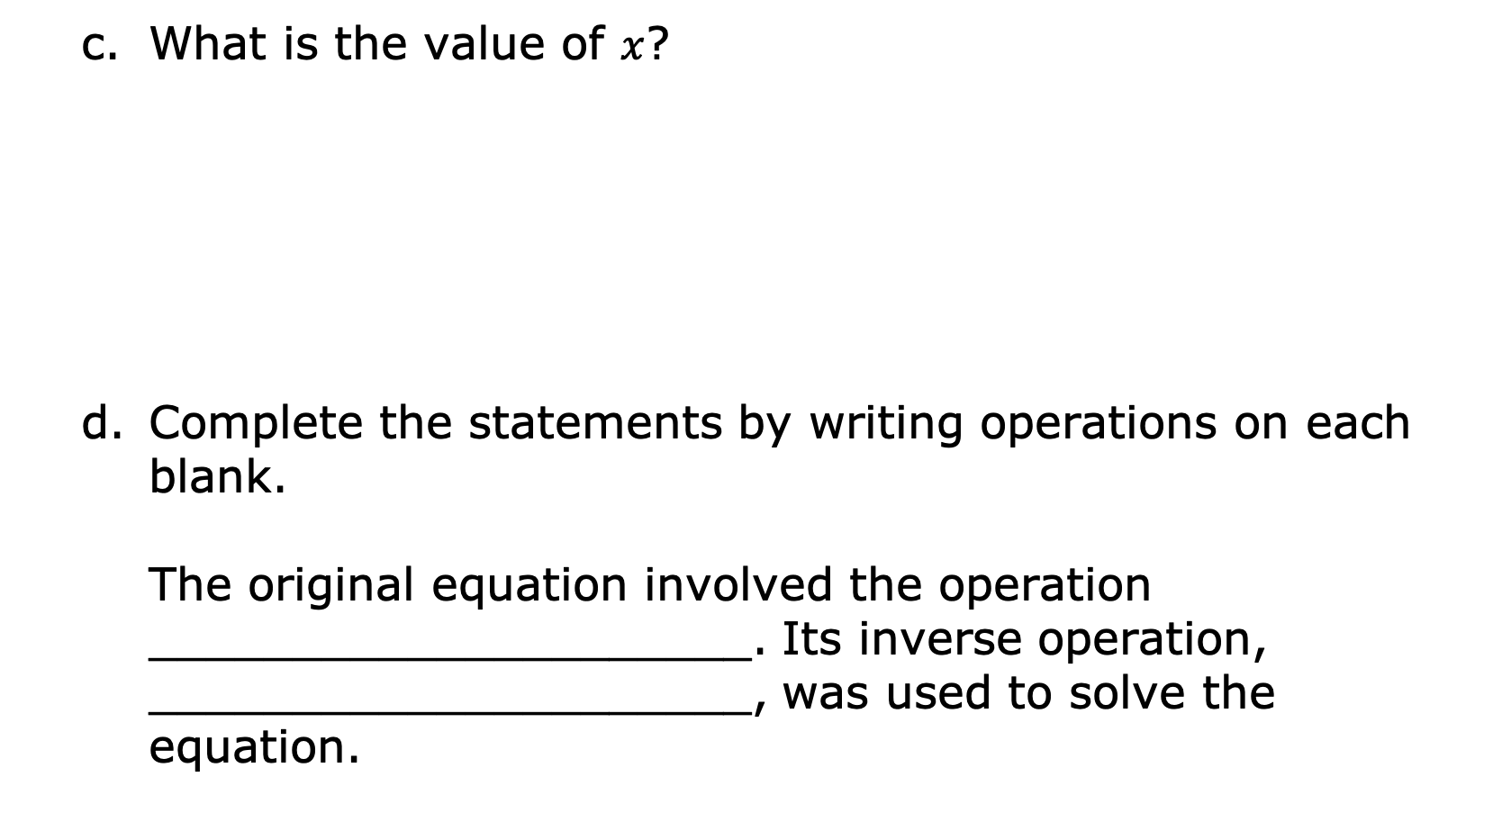
What is the value of $x$?
Complete the statements by writing operations on each blank.
The original equation involved the operation _____________________. Its inverse operation, _____________________, was used to solve the equation.
volume 2, pg. 371

Slide 23
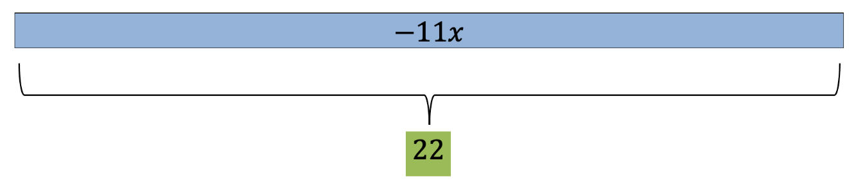
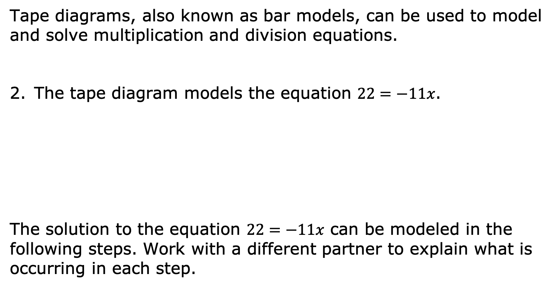
Tape diagrams, also known as bar models, can be used to model and solve multiplication and division equations.
The tape diagram models the equation $22=−11x$.
The solution to the equation $22=−11x$ can be modeled in the following steps. Work with a different partner to explain what is occurring in each step.
volume 2, pg. 371

Slide 24
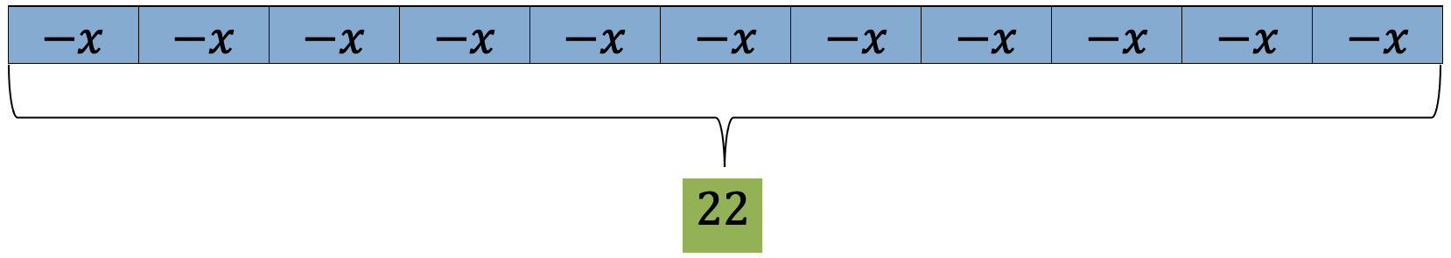
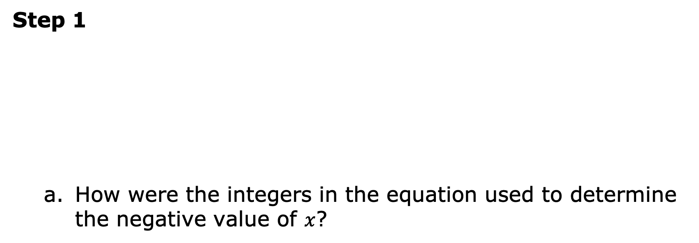
Step 1
How were the integers in the equation used to determine the negative value of $x$?
Explanation of Step 1
volume 2, pg. 371

Slide 25
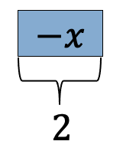
Step 2
Explanation of Step 2
volume 2, pg. 372

Slide 26
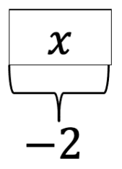
Step 3
Explanation of Step 3
volume 2, pg. 372

Slide 27
Discuss with your partner how the operation used in the equation relates to the operation used in the solution. Summarize your discussion.
volume 2, pg. 372

Slide 28

Collaboration
volume 2, pg. 372

Slide 29

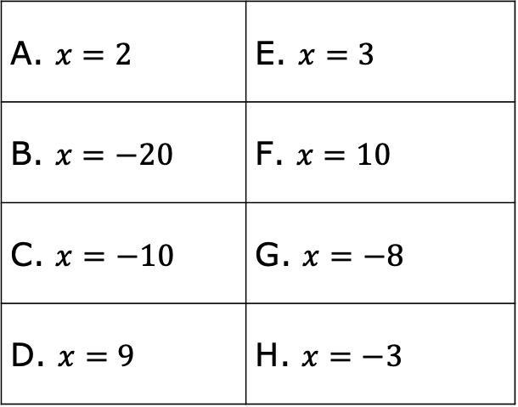
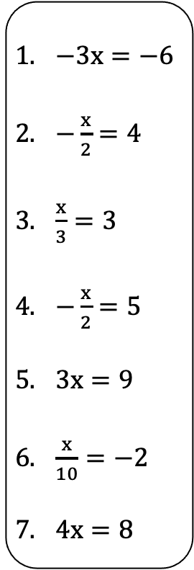
14.6.4 Collaboration: Matching Equations and Solutions
Match each equation to the correct solution. Record the equation with its solution in the table. Some solutions may be used more than once or not at all. Include an explanation for the match.
$−3x=−6$
$−\frac{x}{2}=4$
$\frac{x}{3}=3$
$−\frac{x}{2}=5$
$3x=9$
$\frac{x}{10}=−2$
$4x=8$
A. $x=2$ | E. $x=3$
B. $x=−20$ | F. $x=10$
C. $x=−10$ | G. $x=−8$
D. $x=9$ | H. $x=−3$
volume 2, pg. 372

Slide 30
Equation | Solution | Explanation for Match
volume 2, pg. 373

Slide 31

Wrap-Up
volume 2, pg. 373

Slide 32
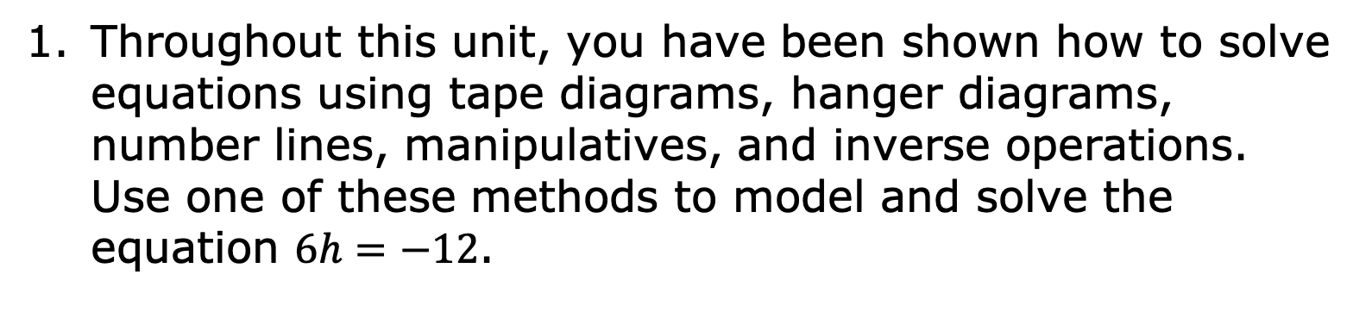
14.6.5 Wrap-Up: Ticket Out the Door
Throughout this unit, you have been shown how to solve equations using tape diagrams, hanger diagrams, number lines, manipulatives, and inverse operations. Use one of these methods to model and solve the equation $6h=−12$.
volume 2, pg. 373

